Slide 1
Year 9 Pythagoras
Investigation introduction

Slide 2
What you need to do:
You will need to design a rollercoaster for Adventure World.
You will need to work out how long the roller coaster will be, and how much it would cost to build.
You also need to write a report with your calculations and design.
We are using Pythagoras theorem to help us model the slant lengths, and you can use circles to represent loops.

Slide 3
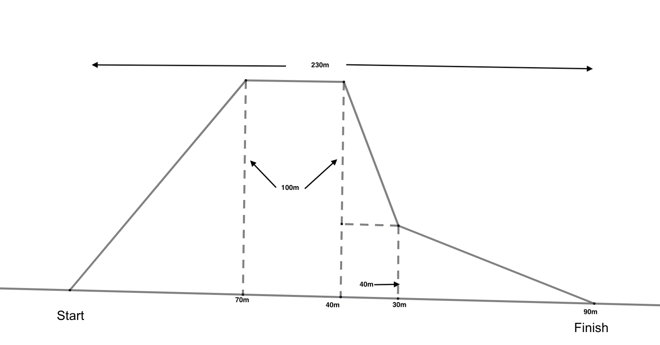
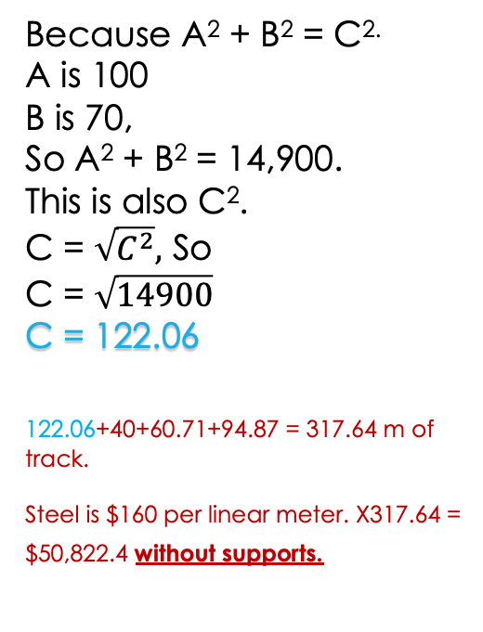
Example
Because A² + B² = C^{2.}
A is 100
B is 70,
So A² + B² = 14,900.
This is also C².
C = $\sqrt{C^{2}},$ So
C = $\sqrt{14900}$
C = 122.06
122.06+40+60.71+94.87 = 317.64 m of track.
Steel is $160 per linear meter. X317.64 = $50,822.4 without supports.
This rollercoaster is made up of three Right-triangles

Slide 4
Where to from here?
You will need to begin to design a roller coaster yourself.
You will need to consider all of the information given to you, and investigate the things you don’t.
Collaboration is encouraged, but productivity needs to be top priority. You only have two in class sessions.
Your design should be unique. You report should be neat.
Are there any questions?

